Slide 1
Christopher Columbus: His journey to Puerto Rico
By: Karla Sanchez

Slide 2
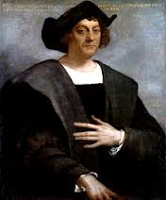
A great explorer or a disturbed, evil man?

Slide 3
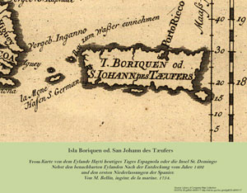
His 2nd Voyage..
Puerto Rico is one of the world’s oldest colonies, having been under some form of military occupation since 1508. On November 19, 1493, during his second voyage, Christopher Columbus arrived in Puerto Rico. He stayed there for about 2 days.

Slide 4
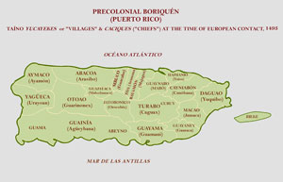
Puerto Rico
The island was populated by the indigenous Tainos. The Taíno called the island Borikén (Spanish Boriquen), “the land of the brave lord.” Columbus named the island San Juan Bautista in honor of Saint John the Baptist.
He described the Taino people as gentle, good people and easy to convert to Christianity.
The population was of 30,000.

Slide 5
15 years later…..
For the next fifteen years, the Spaniards left Puerto Rico (called San Juan Bautista) alone, and the 30,000 TAINO inhabitants saw little of them except when they made occasional visits for trading, etc. But then, in 1508, Ponce De Leon and a band of about 50 men established a settlement (Ciudad de Puerto Rico) on the island. Ponce had made a secret deal with the Spanish governor of the Caribbean to search for gold on the island.

Slide 6
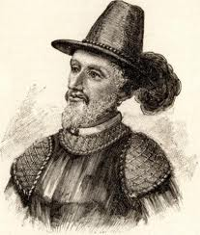
They had noticed that the Tainos wore gold necklaces and rings. The Spaniards asked them where did they get them from and the Taino told them that they’d find gold nuggets when they washed offshore.
For the next year, Ponce de Leon and the Taino became well acquainted and lived comfortably. Just then, king Ferdinand received news about the gold and the possible profit it could make, therefore he sent family members and friends, and that’s when everything changed.

Slide 7
Ponce de Leon tried as much as he could to protect the Tainos, but was unsuccessful. They were killed off over the next 15 or so years because of diseases brought by the Spaniards and their enslavement. The Tainos rebelled but were yet again unsuccessful.
Later, King Ferdinand took the power away from Ponce de Leon, giving him permission to explore Florida. Ponce de Leon left Puerto Rico, making it easier for the Spaniards to keep killing and enslaving Tainos. Soon enough, the Tainos were a dying group of indigenous indians.

Slide 8
In conclusion, Christopher Columbus, to me, was not an evil, disturbed man, he was a great explorer who made wrong decisions.
Although, he committed a lot bad doings, you have to keep in mind it was different at the time. The downfall of the Taino people is not fully Columbus’ fault, it was more King Ferdinands’ and other Spaniards because Columbus didn’t stay long enough to make any damage, he left right away. His mistake was calling attention to the island.
Christopher Columbus was a disturbed man and a great explorer.

Slide 9
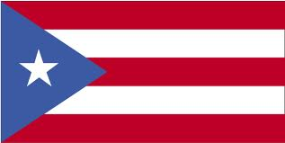
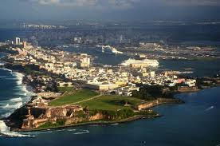
THE END!

