Slide 1
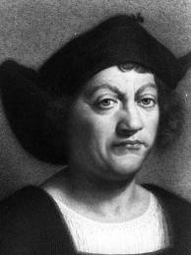
Christopher columbus friend or foe? By osvaldo “section” lobos

Slide 2
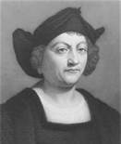
who
Christopher Columbus was born in Genoa (located in Italy today ) in 1451, to Domenico Colombo, a middle class wool-weaver, and Susanna Fontanarossa.

Slide 3
What
Columbus first took to the sea when he was 14 years old and this continued throughout his younger life.

Slide 4
where
During the 1470’s , he went on numerous trading trips that took him to the Aegean Sea, Northern Europe and possibly Iceland.
In 1479, he met his brother Bartolomeo, a mapmaker, in Lisbon.

Slide 5
why
For years, Columbus proposed his plans to the Portuguese and Spanish Kings, but he was turned down each time.

Slide 6
When
Finally, after the moors were expelled from Spain in 1492, king Ferdinand and Queen Isabella reconsidered his request.

Slide 7
Is Columbus is a friend?
Columbus promised to bring back gold, spices and silk from Asia, spread Christianity, and China.
He then asked to be admiral of the seas and governor of discovered lands.

Slide 8
Was Columbus fame or not?
Because of his discoveries, Columbus is often venerated in areas around the world, but notably in the Americas with his name on places (such as District of Columbia) and the celebration of Columbus Day every year on the second Monday October.

